Slide 1

Progress Presentation
06-11-2024
Prepared by: Marie Joe Sawma To: Dr. Reed Maxwell

Slide 2
Part 1: Collection of Data

Slide 3
Data Collection: Sources
Collecting data from ParFlow-CLM simulations alongside observational data from AmeriFlux provides a realistic range of possible values. By incorporating observational data to the simulated data range, we achieve a closer convergence to real-world values, enhancing the accuracy and reliability of the model

Slide 4
Time Series Resolution
An hourly time series can capture the fluctuations in latent heat throughout the day. It allows for a more precise analysis of the relationships between latent heat and environmental factors influencing its behavior.

Slide 5
Location: Influencing Factors
Air Temperature: Higher air temperatures increase the rate of evaporation and transpiration.
Humidity Levels: When the air is saturated with moisture, less evaporation occurs.
Wind Speed: Wind enhances evaporation by removing saturated air and replacing it with drier air, allowing more moisture to evaporate.

Slide 6
Soil Moisture: Wet soils allow more water to evaporate, leading to higher latent heat fluxes.
Solar radiation: Solar radiation is the primary energy source for evaporation and transpiration. High radiation levels increase surface temperature, leading to more evaporation.

Slide 7
Locations : Environmental Conditions
Environmental conditions for each location are checked using AmeriFlux data before running ParFlow-CLM. This ensures that we capture the full range of variability, allowing for an accurate representation of latent heat across different scenarios.

Slide 8
Location: Ameriflux Selection
This approach influences the selection of AmeriFlux site IDs used for comparison with simulated data from ParFlow. When two AmeriFlux sites are located close to each other under similar conditions, only the site with the most extensive data will be selected, as it provides greater data and captures variability across multiple years.

Slide 9
Time Period : Selection
The fact that each Ameriflux site covers different time periods is indeed a source of bias when trying to represent latent heat values in a single histogram. This leads to over representation of certain conditions or timeframe and under representation of others, skewing frequency distribution of Latent Heat values.
Proposed Solution: An approach to address bias due to differences in time periods is to assign a weight to each site based on its total number of observations.

Slide 10
Part 2 : Quality of Data

Slide 11
Data Quality Assessment
Collecting Data From Ameriflux - US-Ne2
Collecting Data From PFCLM RUN
Calculating the Difference Between Observed Data and ParFlow Model Output
Calculating the Percentage Error
Filtering the Data
Check the Proportion of Data Within Limits
Summary Statistics Calculation for Filtered Data

Slide 12
Collection of Data
Data was collected over a one-year period, starting on October 10, 2018, and ending on October 10, 2019, in the state of Nebraska. The AmeriFlux site for this data is US-Ne2.

Slide 13
Percentage of Error
This involves calculating the difference between the observed measurements from AmeriFlux and the values generated by the ParFlow run, and then calculating the percentage error for each data point, using the observation data as the reference.

Slide 14
Limits of Acceptability
To analyze data points with minimal deviation between ParFlow and AmeriFlux, we filter the DataFrame to include only rows where the percentage error is 15% or less.

Slide 15
Proportion of Filtered Data
The filtered data represents only 10% of the AmeriFlux and ParFlow-CLM datasets.

Slide 16
Statistical Summary
Mean: 135.739973 (W/m²)
Minimum : -18.9 (W/m²)
Maximum : 586.4 (W/m²)
IQR : 225.0 (W/m²)

Slide 17
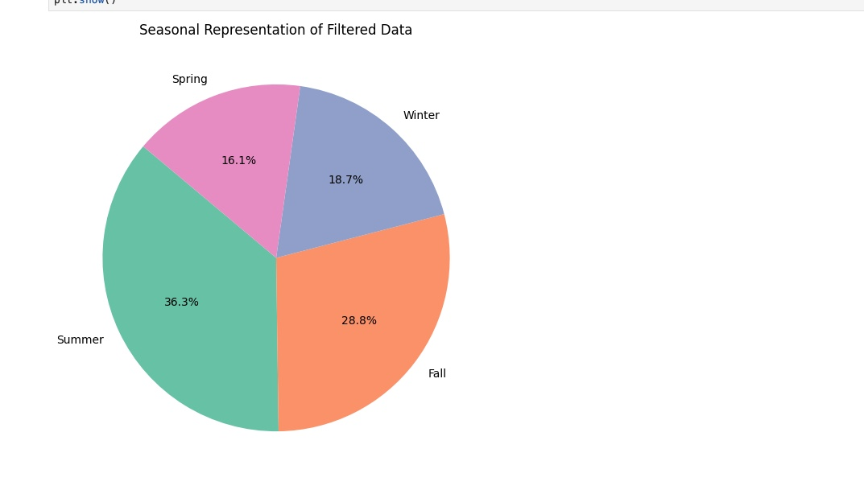

Slide 18
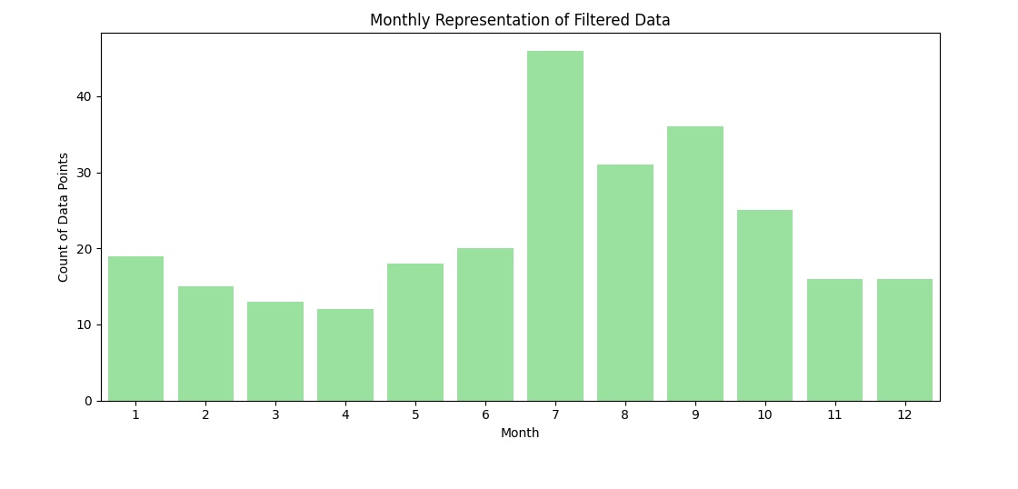
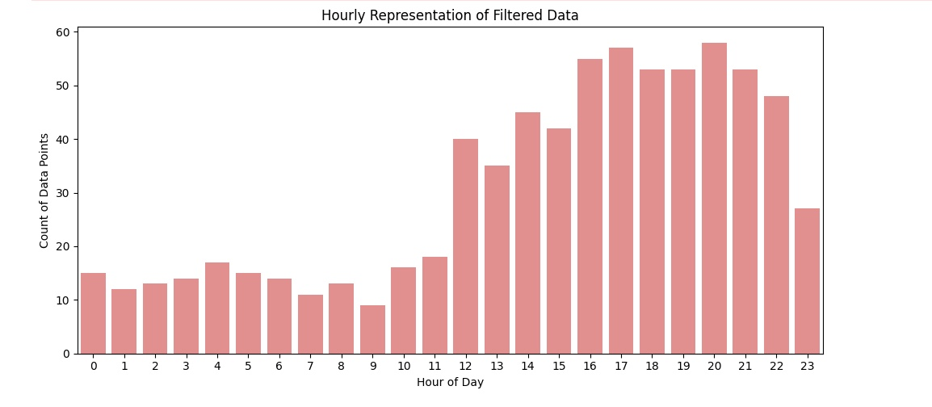

Slide 19
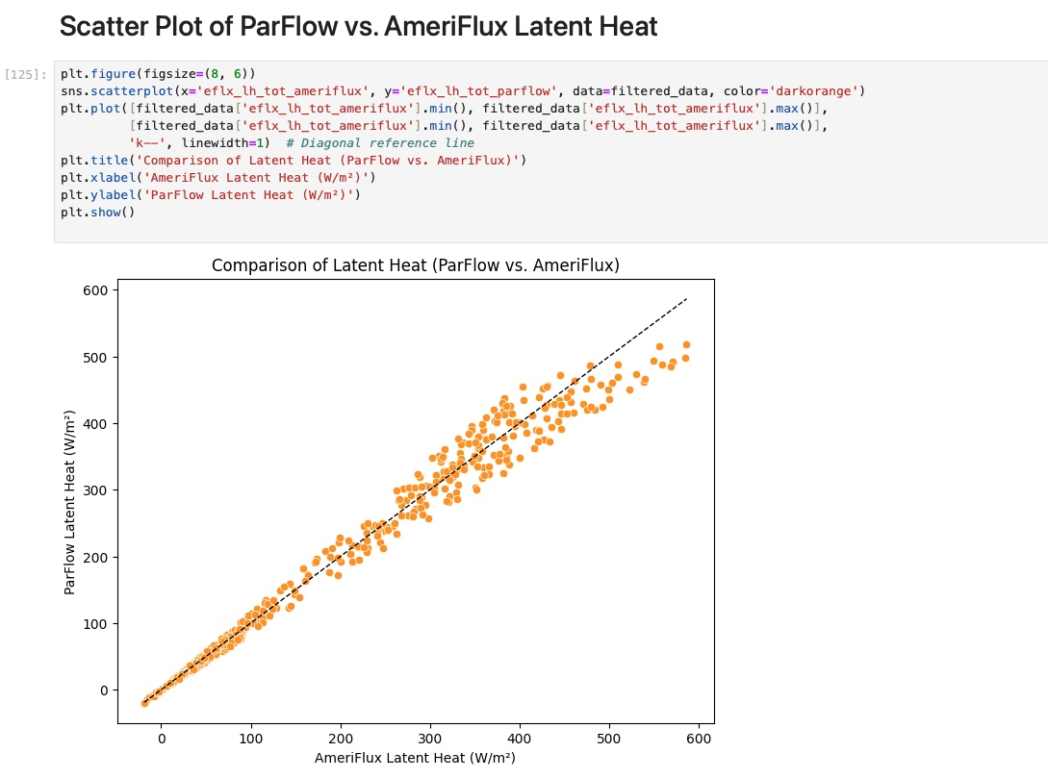
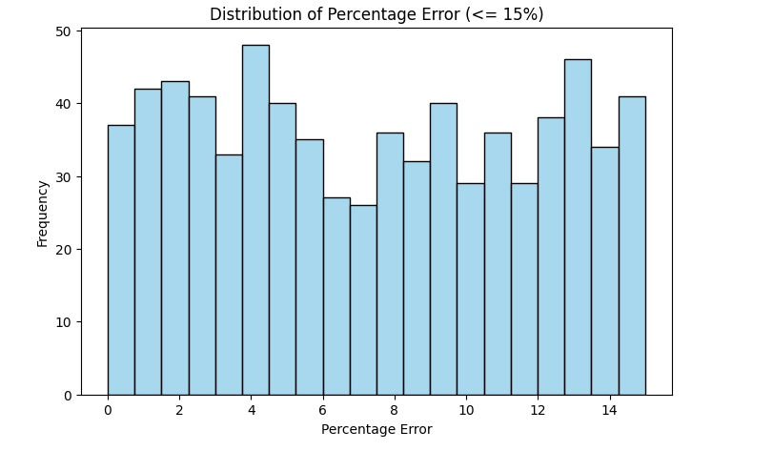

Slide 20
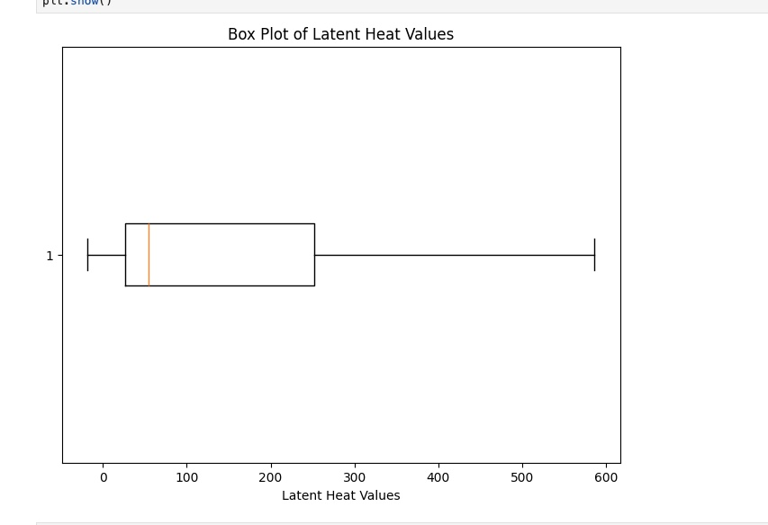

Slide 21
Analysis
Assessing the bias in the selection of points : if the points that are selected from a part of the domain where Parflow naturally perform better, this can introduce a positive performance bias. This would mean that the selected points do not fully represent the overall domain but instead reflects where Parflow is already known to perform better.
Therefore, this means that in areas with different environmental conditions where Parflow might struggle, the model is less likely to adapt accurately because the prior does not contain enough information.

Slide 22
Plotting The Distribution of Ameriflux vs Parflow Run vs Filtered Data

Slide 23
Part 4: Prior Distribution

Slide 24
Prior Distribution
Planning to build a histogram that provides a visual frequency distribution of Latent heat
Converting the Histogram to a Probability distribution
Testing how well data fits distribution (normal, gamma, beta…)

Slide 25
Part 5: Evapotranspiration

Slide 26
Evapotranspiration Approach
The standard unit for measuring evapotranspiration is mm/day. This unit is ideal for evapotranspiration analysis as it represents the actual amount of water lost through evaporation and transpiration. Using mm/day allows us to estimate and understand water loss, which is crucial for hydrological modeling.

Slide 27
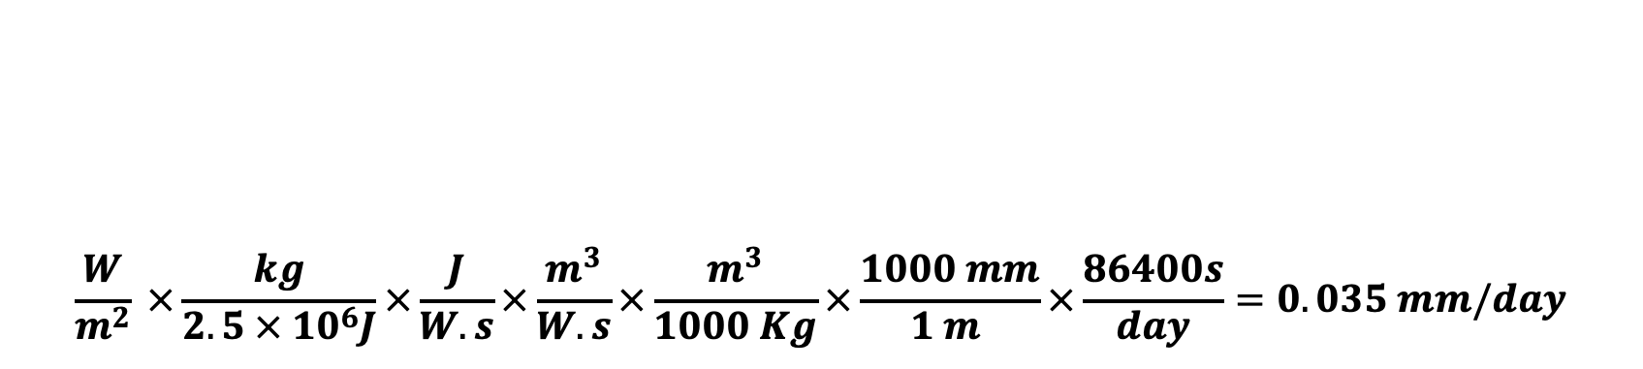
Evapotranspiration Approach
$$\frac{W}{m^{2}} ×\frac{kg}{2.5 × {10}^{6}J}×\frac{J}{W.s}×\frac{m^{3}}{W.s}×\frac{m^{3}}{1000 Kg}×\frac{1000 mm}{1 m }×\frac{86400s}{day}=0.035 mm/day$$

Slide 28
Question
What is the outcome variable Y when treating latent heat as the parameter ?
Where will the distribution of latent heat be used?
The ParFlow-CLM script does not account for leap years. Should I include this information?

Slide 29
Question
Is the "prior" linked to the initial values assigned to weights in SBI when finding the conditional probability?
When we refer to "posterior," does this term imply the final or adjusted weights after the model has been trained ?
There is still a question on my notebook (familiarity of nodes and dimension)

Slide 30
Question
Texas has only one AmeriFlux site, which encountered an issue in 2018. All values recorded that year are zero, suggesting a malfunction.
Some AmeriFlux sites have missing values. Should I exclude these years from the analysis?
Facing a problem when I am running for more than one year.

Slide 31
Question
Running the single-column model for a 20-year period takes approximately one hour.
I am working with all available data and applying a data-cleaning method (shrinking the range).

Slide 32
Thank you

